Slide 1


Final Year Project Work Final Defense
On
E-Novel Recommendation Using Collaborative Filtering Algorithm
Presented by
Laxmi Maya Khatri(20806/075)
Manisha KC (20809/075)
Ranu Dhungel (20822/075)
B.Sc. CSIT VII (2075)
2080/01/15

Slide 2
Presentation Outline
About Project
System Analysis
System Design
System Implementation
Conclusions and Future Enhancement
Appendix

Slide 3
About Project
Project Introduction
The project is aimed at developing an e-novel recommendation system using collaborative filtering.
The system will use data from user ratings and interactions with books to provide personalized book recommendations.
The algorithm will identify similar users and books based on their ratings and interactions and provide recommendations based on the similarities.

Slide 4
About Project
Problem Statement
Difficulty in finding books in different regions.
Lack of proper knowledge on books.
Interest in finding new authors and books.
Hesitance to buy books due to costing.

Slide 5
About Project
Objectives
To enable users to search for books based on different criteria such as title, author, category, etc.
To provide user friendly experience of reading books.
To implement collaborative filtering algorithm for improving the web application.
Project Scope
To provide accurate and personalized book recommendations to users.
To enhance the user experience and increase sales for e-book retailers.
To offer features such as bookmarks, ratings, and reviews to enhance the user experience.

Slide 6
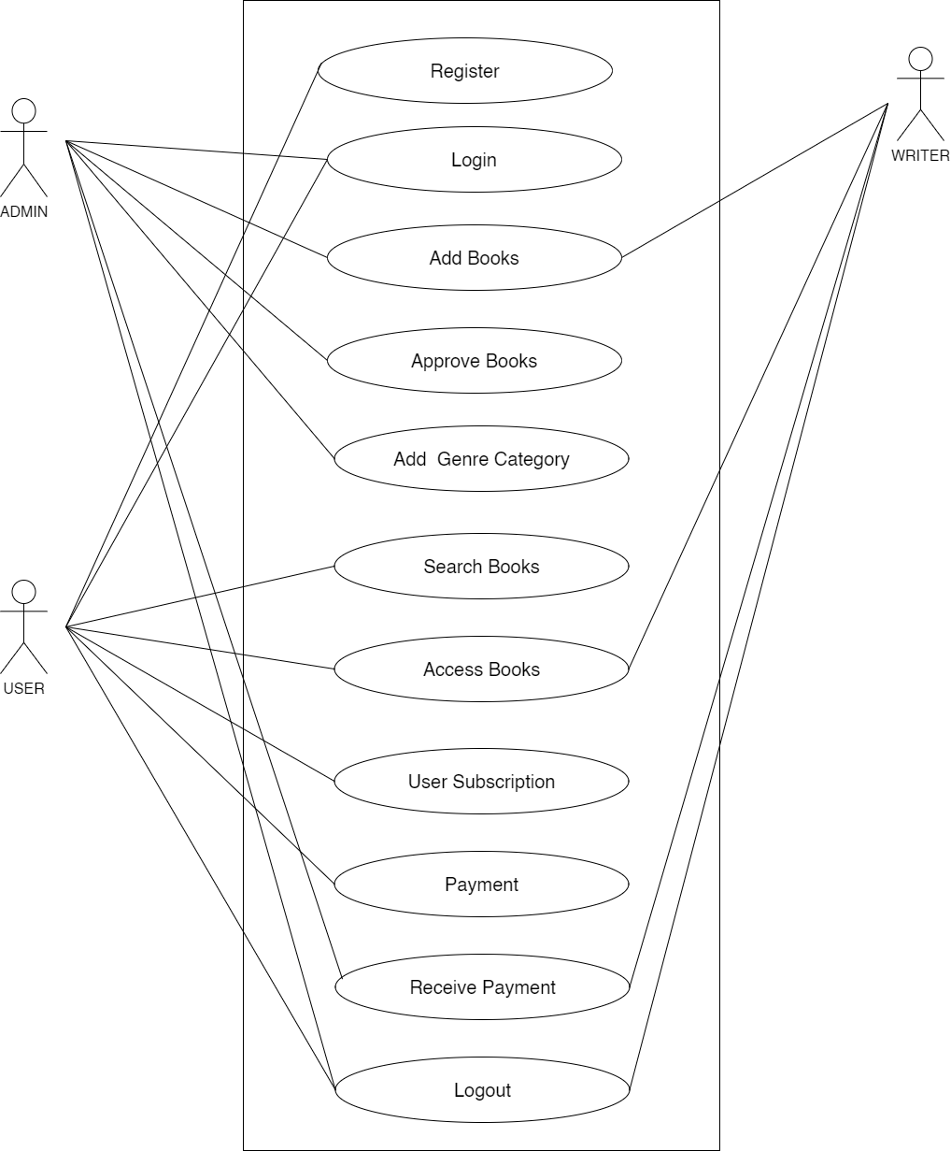
System Analysis
Functional Requirements
Use Case Diagram

Slide 7
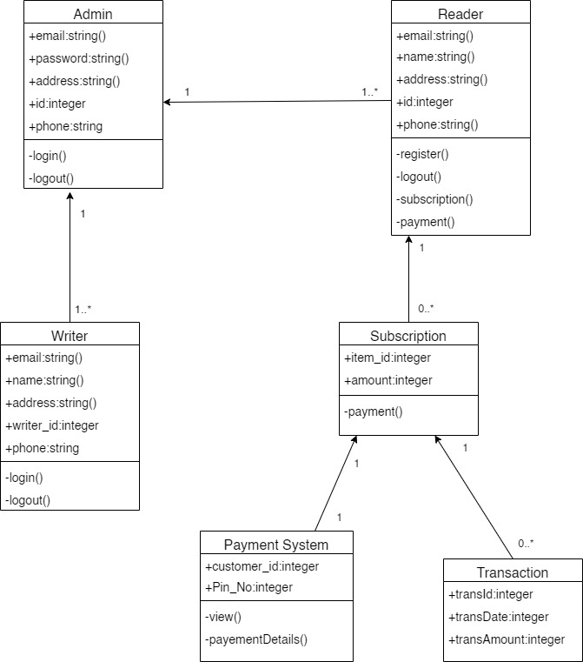
System Design
Class Diagram

Slide 8
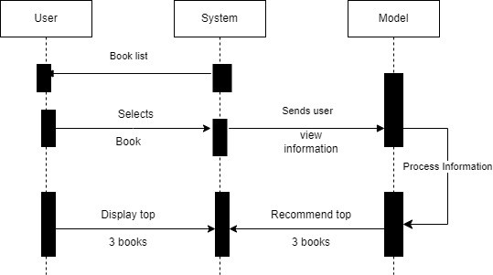
System Design
Sequence Diagram

Slide 9
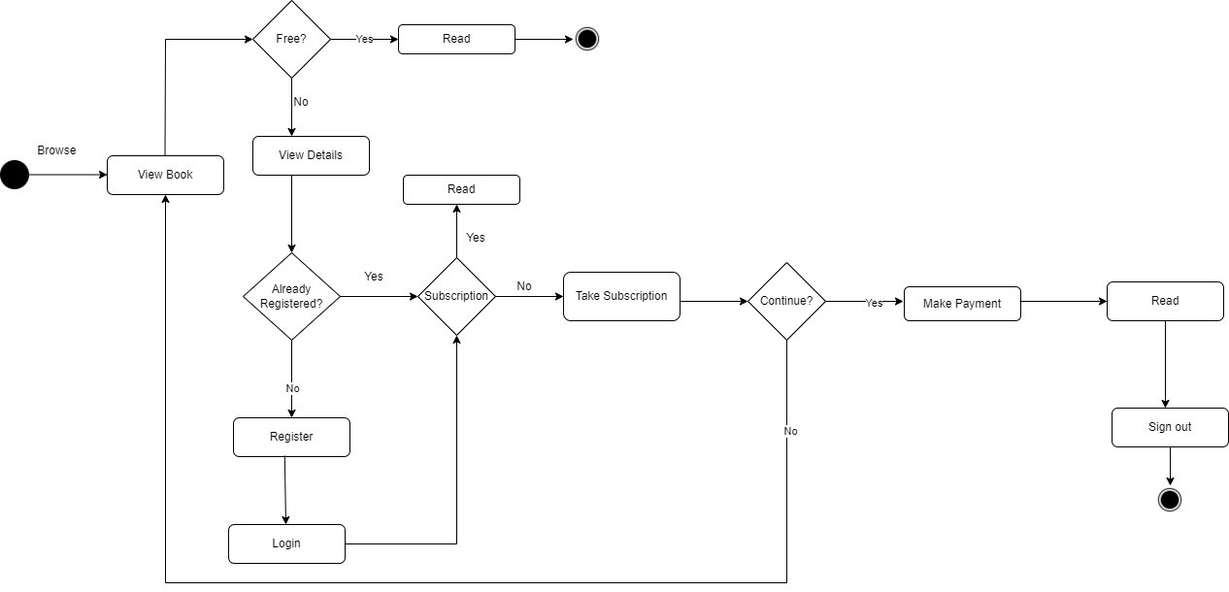
System Design
Activity Diagram

Slide 10
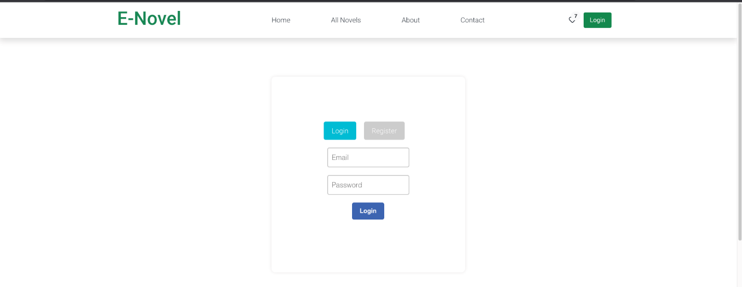
Form Design

Slide 11
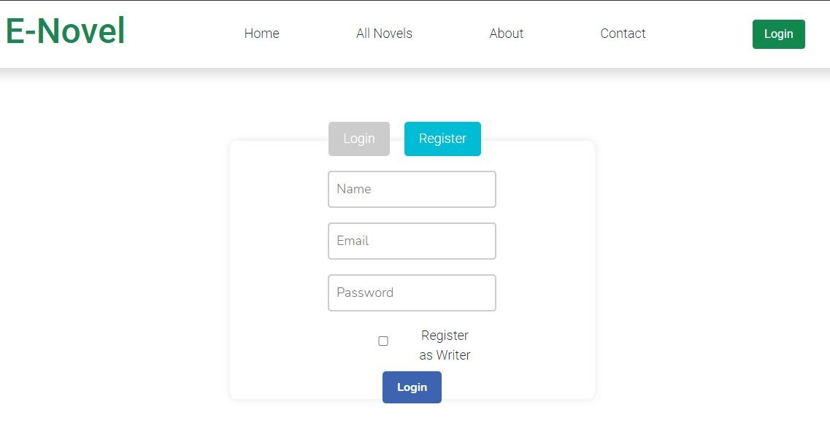

Slide 12
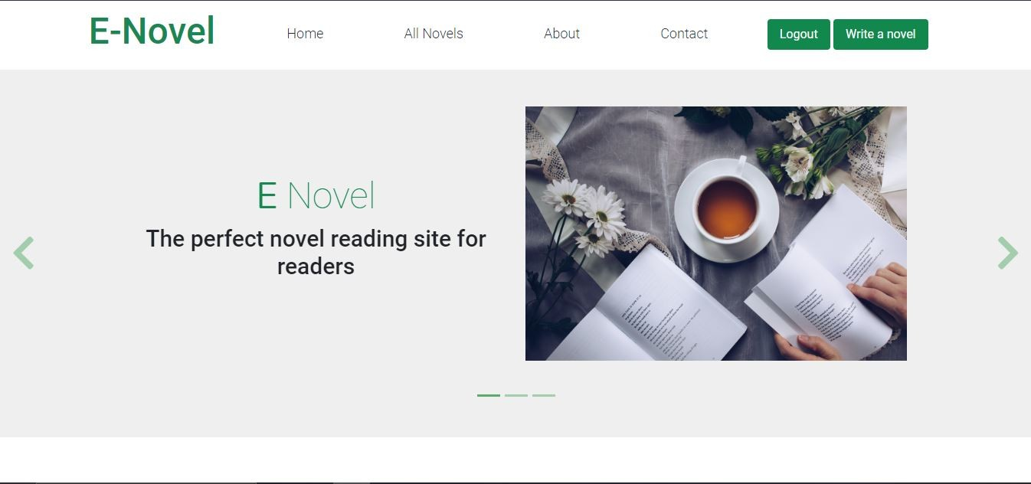
Interface Design

Slide 13
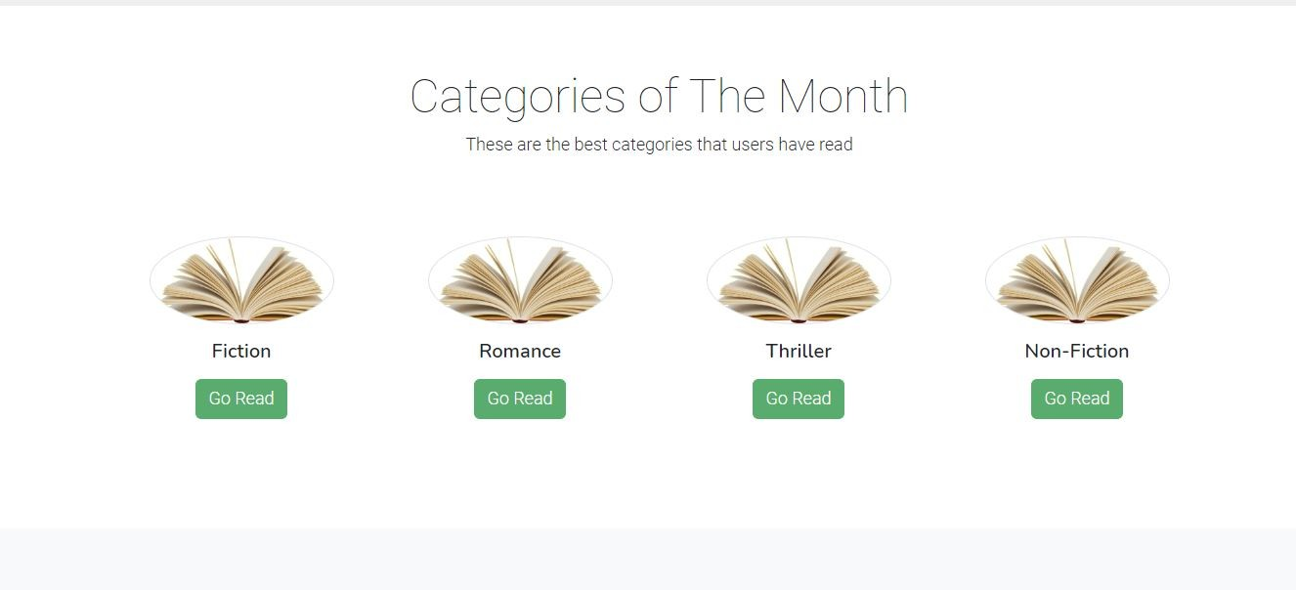

Slide 14
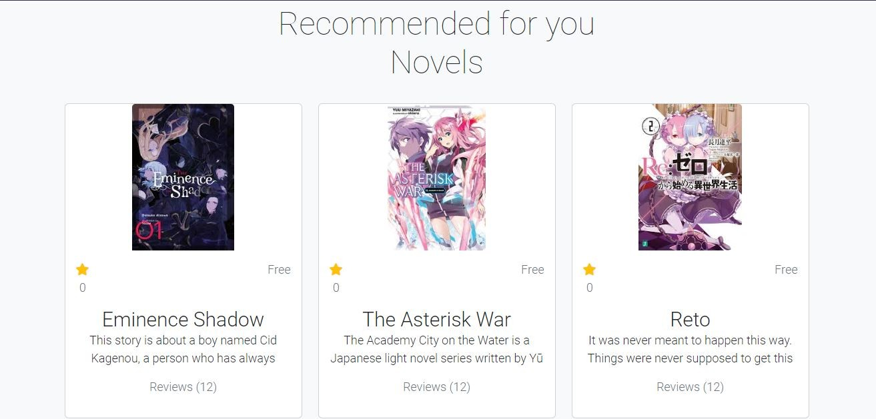

Slide 15
System Implementation
Tools used
Development Tools
HTML
CSS
React JSX
Laravel
Visual Studio Code
MySQL
GitHub with Git

Slide 16
System Implementation
2. Design Tools
Draw.io
Microsoft Project
Microsoft Word
Microsoft PowerPoint

Slide 17
System Implementation
Testing with Test Cases and Test Results Tables
User Registration with name, email and password
Login with correct email and password.
User Subscription
User Payment

Slide 18
Conclusion and Future Enhancement
Final Results/Outcomes
The system is designed to provide a web-based application that would make searching, viewing and selection of a book easier.
The search engine provides an easy and convenient way to search for products where users can search for a product.
On the basis of users input, the search engine would refine the products available for reading. Users can view the product reviews and also write their own reviews.

Slide 19
Conclusion and Future Enhancement
Limitations
This web application is specially made for the audience of Nepal thus the readers of other countries might face problem when buying the premium novels, may have limited storage capacity.
This website may not be able to guarantee the accuracy or quality of the novels uploaded by users.

Slide 20
Conclusion and Future Enhancement
Future Enhancement
In the future, E-novel could continue to improve their offerings by incorporating more advanced technology and features.
They could also integrate virtual reality technology to offer immersive reading experiences or create virtual book clubs and author events.
The system can enhances the incorporating virtual reality technology which could offer an immersive reading experience where customers feel as if they are physically present in the story.

Slide 21
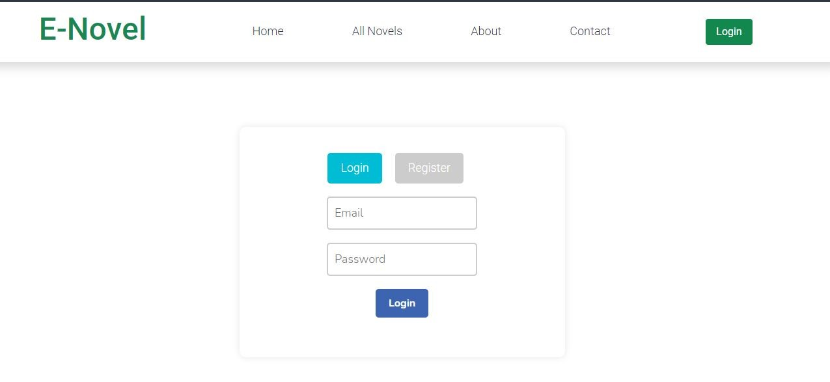
Appendix

Slide 23
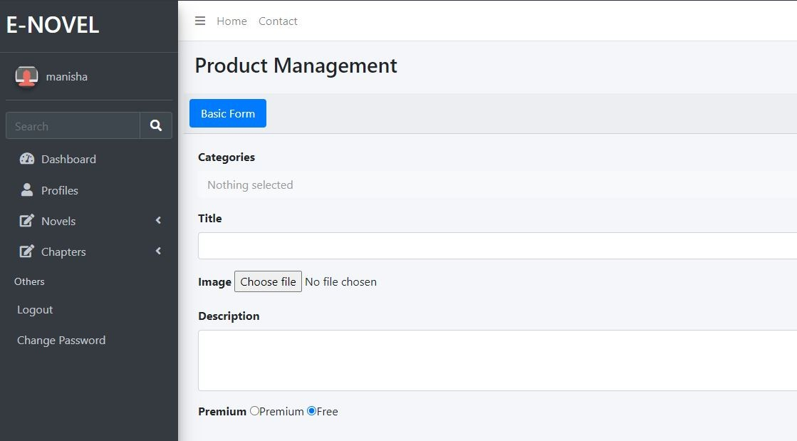

Slide 24
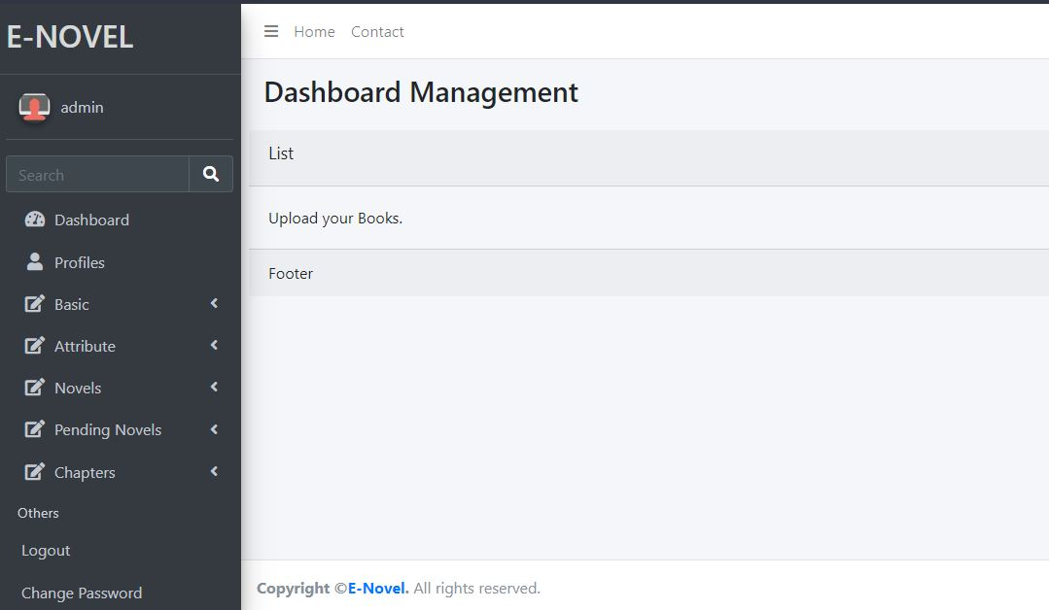

Slide 25
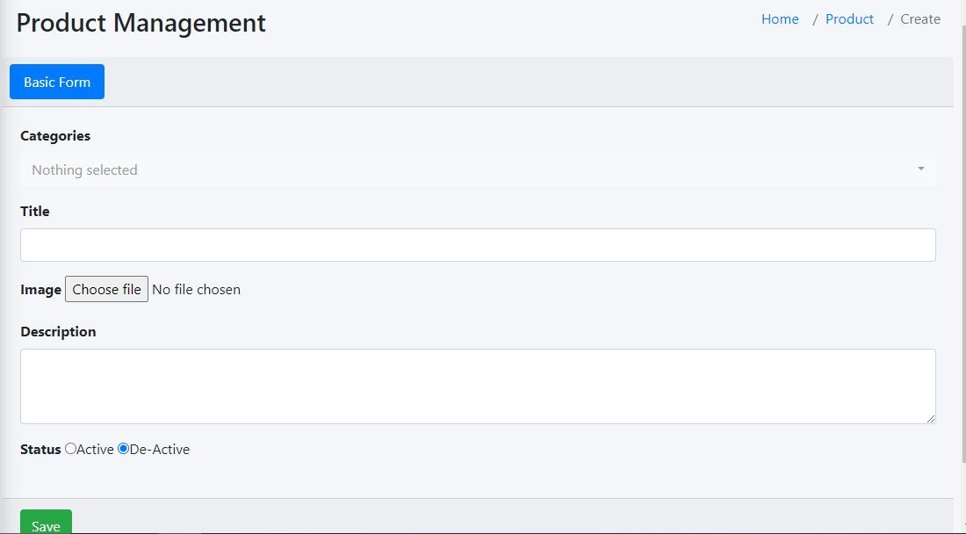

Slide 26
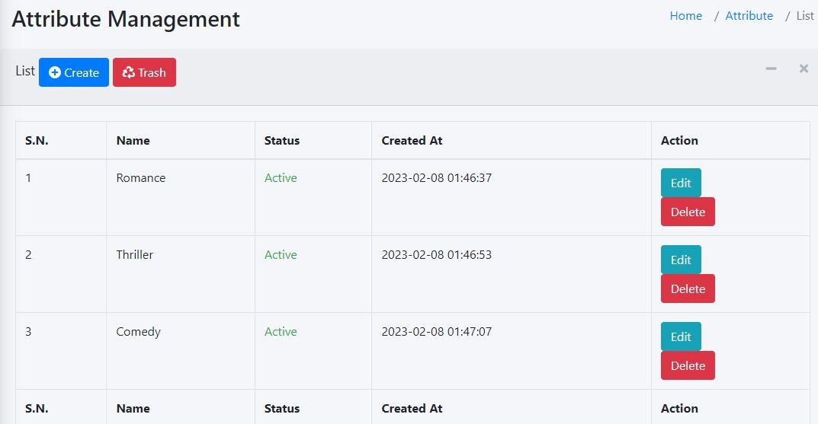

Slide 27
Thank You !!

